Slide 1
Ultrasound circuit flow
指導教授：董蘭榮 教授
研 究 生：林柏佑

Slide 2
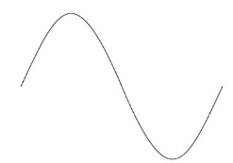

Ultrasound circuit flow
Hardware
Function generator IC
ICL8038(Pin2)
Sine wave
(40kHz)
Buffer
Level shift
Reflect from body
(amplifier)
Mixed
(sin*cos)
&
(cos*cos)
Phase shift
Ultrasound
Cos wave
(40kHz)
Software
Band pass filter
(0.01-10Hz)
(amplifier)
ADC to PC
Demodulation

Slide 3
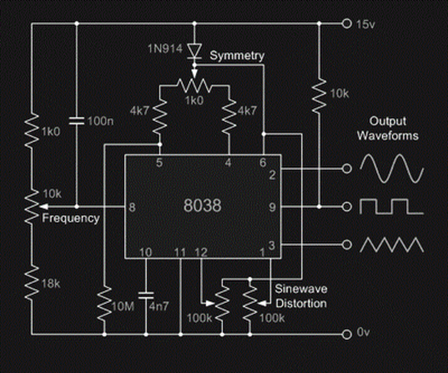
Function generator IC:ICL8038
Pin2:output sine wave(40kHz)

Slide 4
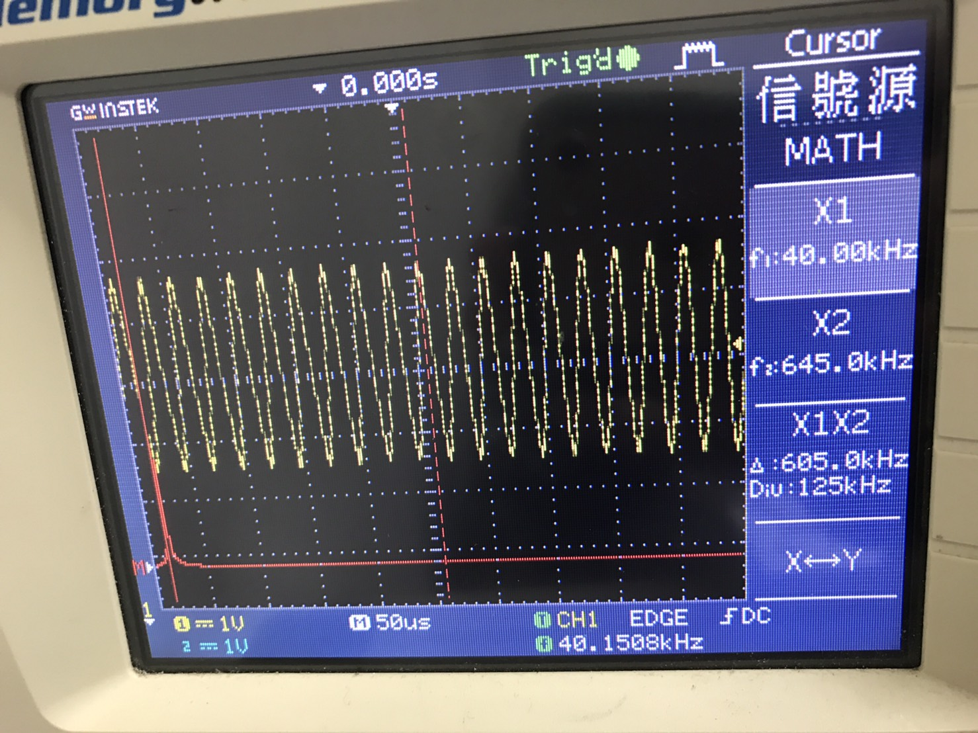
Sine wave(40kHz)

Slide 5
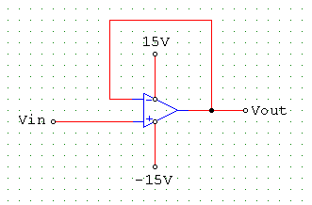
Buffer circuit

Slide 6
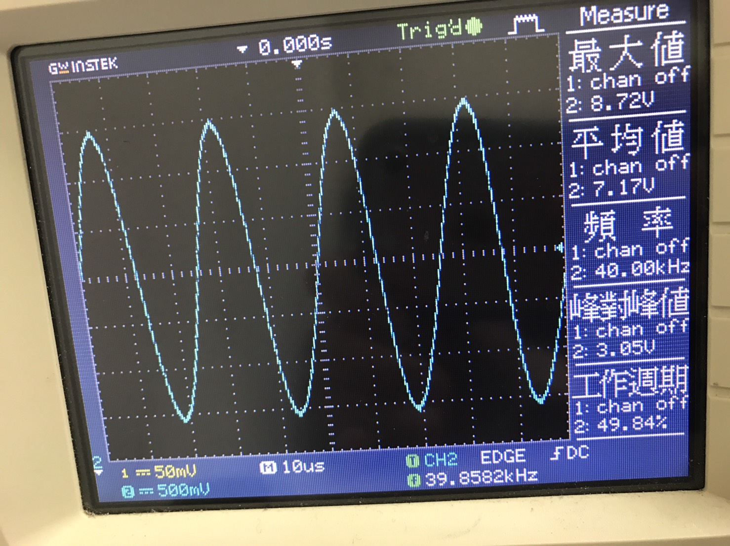
Sine wave after buffer on scope

Slide 7
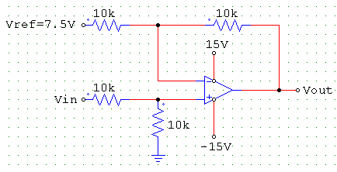
Level shift circuit

Slide 8
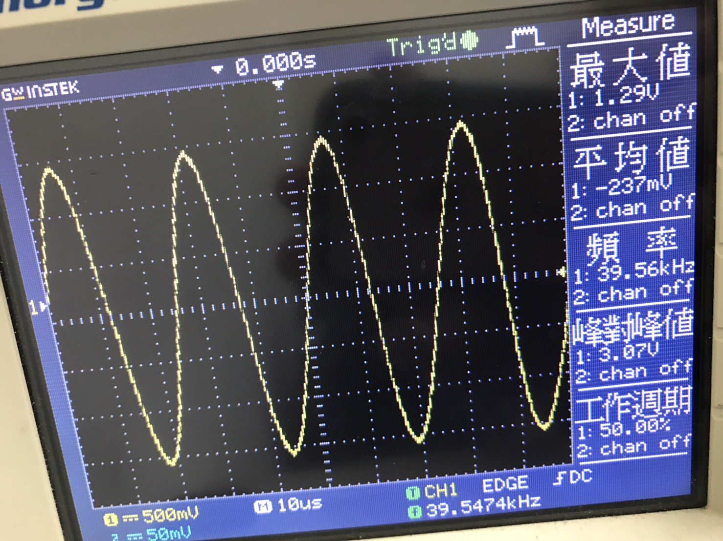
Level shift on scope

Slide 9
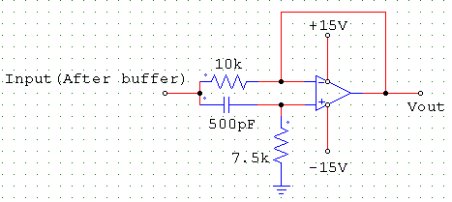
Phase shift circuit

Slide 10
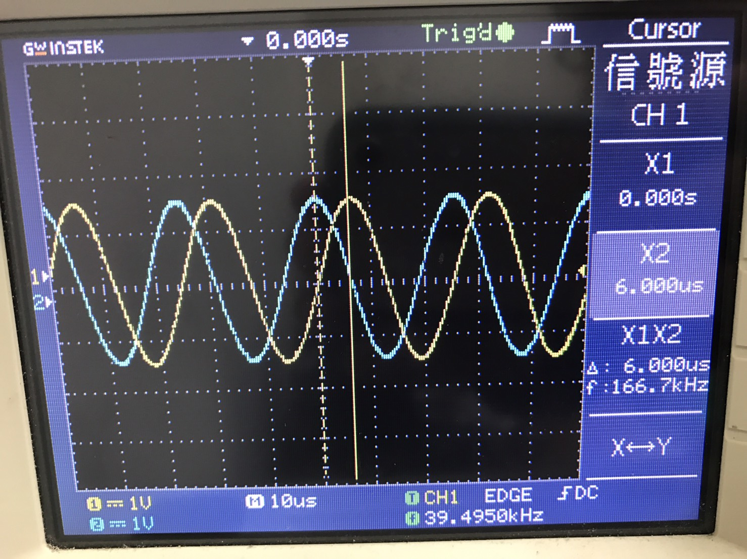
Phase shift on scope

Slide 11
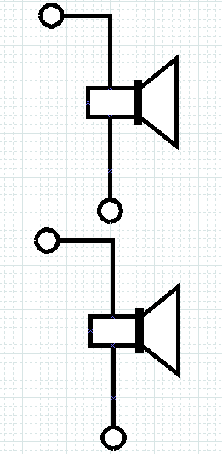
Ultrasound circuit
Cos wave input
Transmitter
Receive signal
Receiver

Slide 12
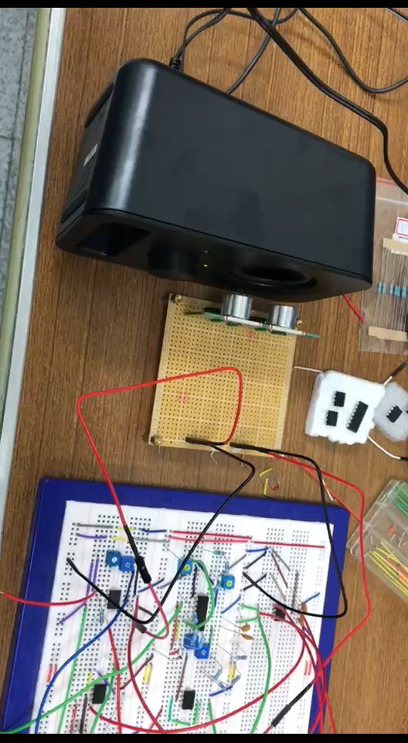
Receive signal & amplifier signal

Slide 13
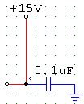
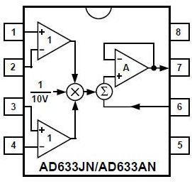
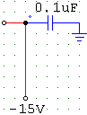
Mixed circuit (sin*cos)&(cos*cos)
(sin*cos)&(cos*cos)

Slide 14
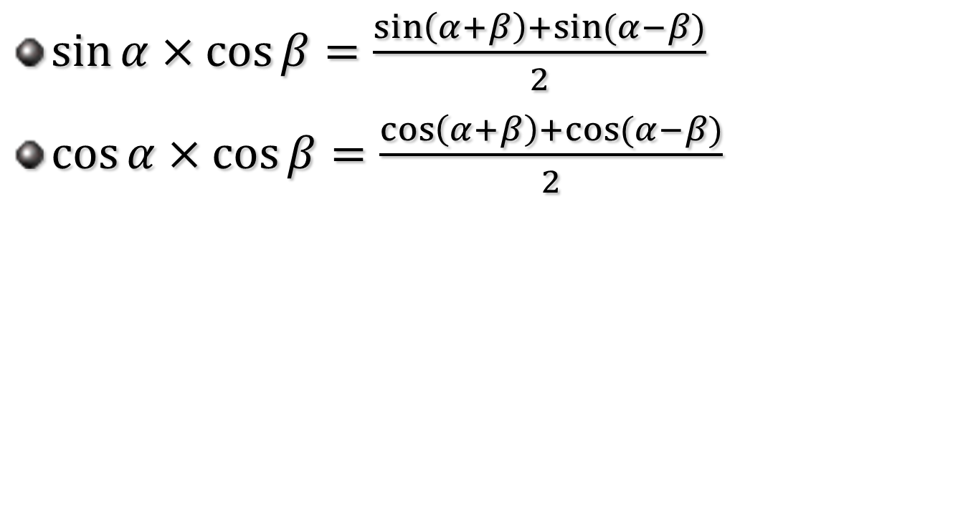
Product-to-sum formula
$\sin{α×\cos{β}}=\frac{\sin\left(α+β\right)+\sin{(α−β)}}{2}$
$\cos{α×\cos{β}}=\frac{\cos\left(α+β\right)+\cos{(α−β)}}{2}$

Slide 15
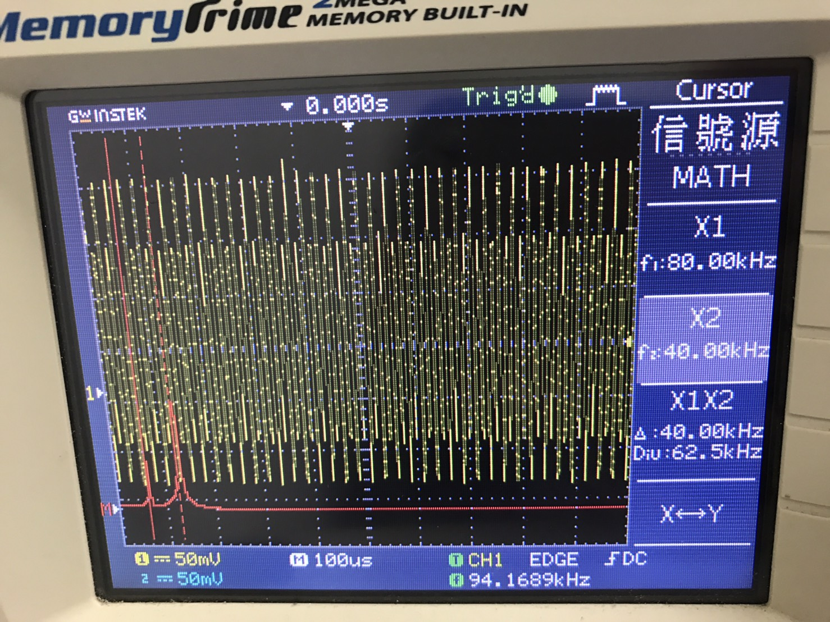
Mixed on scope

Slide 16
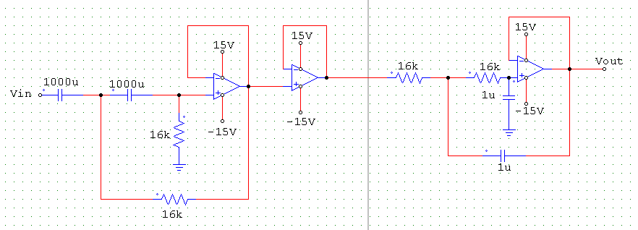
Band pass filter circuit
High pass filter
Cut-off frequency:0.01Hz
Low pass filter
Cut-off frequency:10Hz

Slide 17
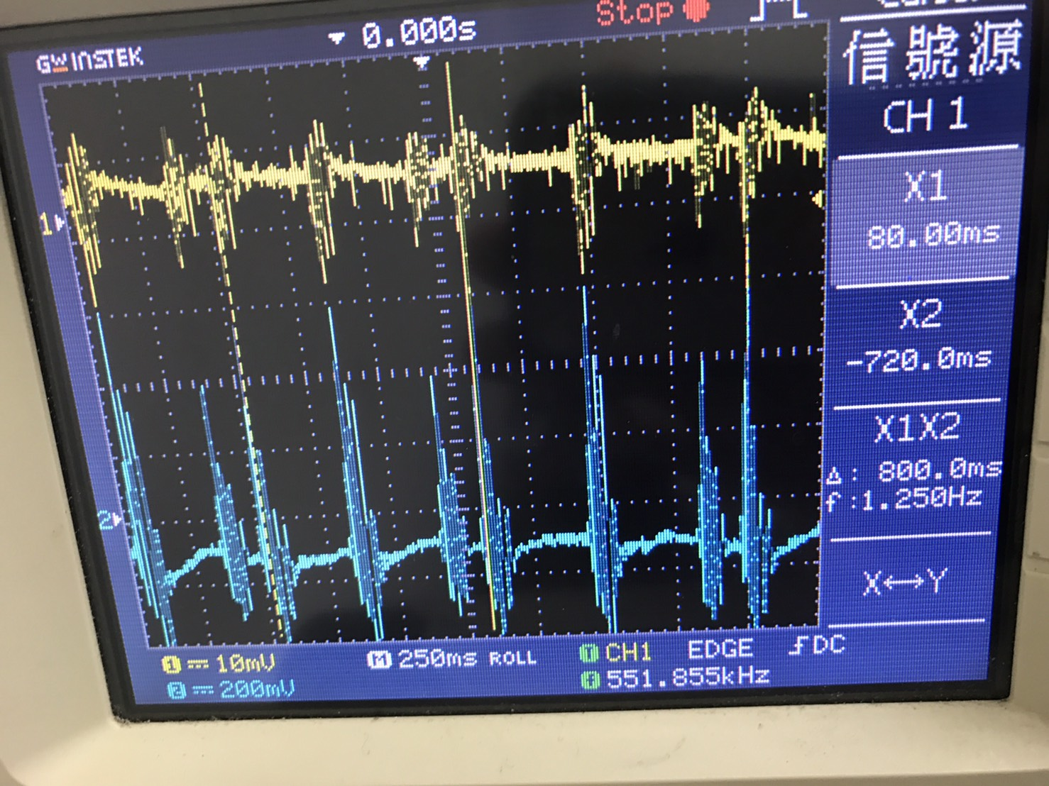
Signal after band pass filter on scope(cos) & amplifier signal
After band pass filter
After amplifier

Slide 18
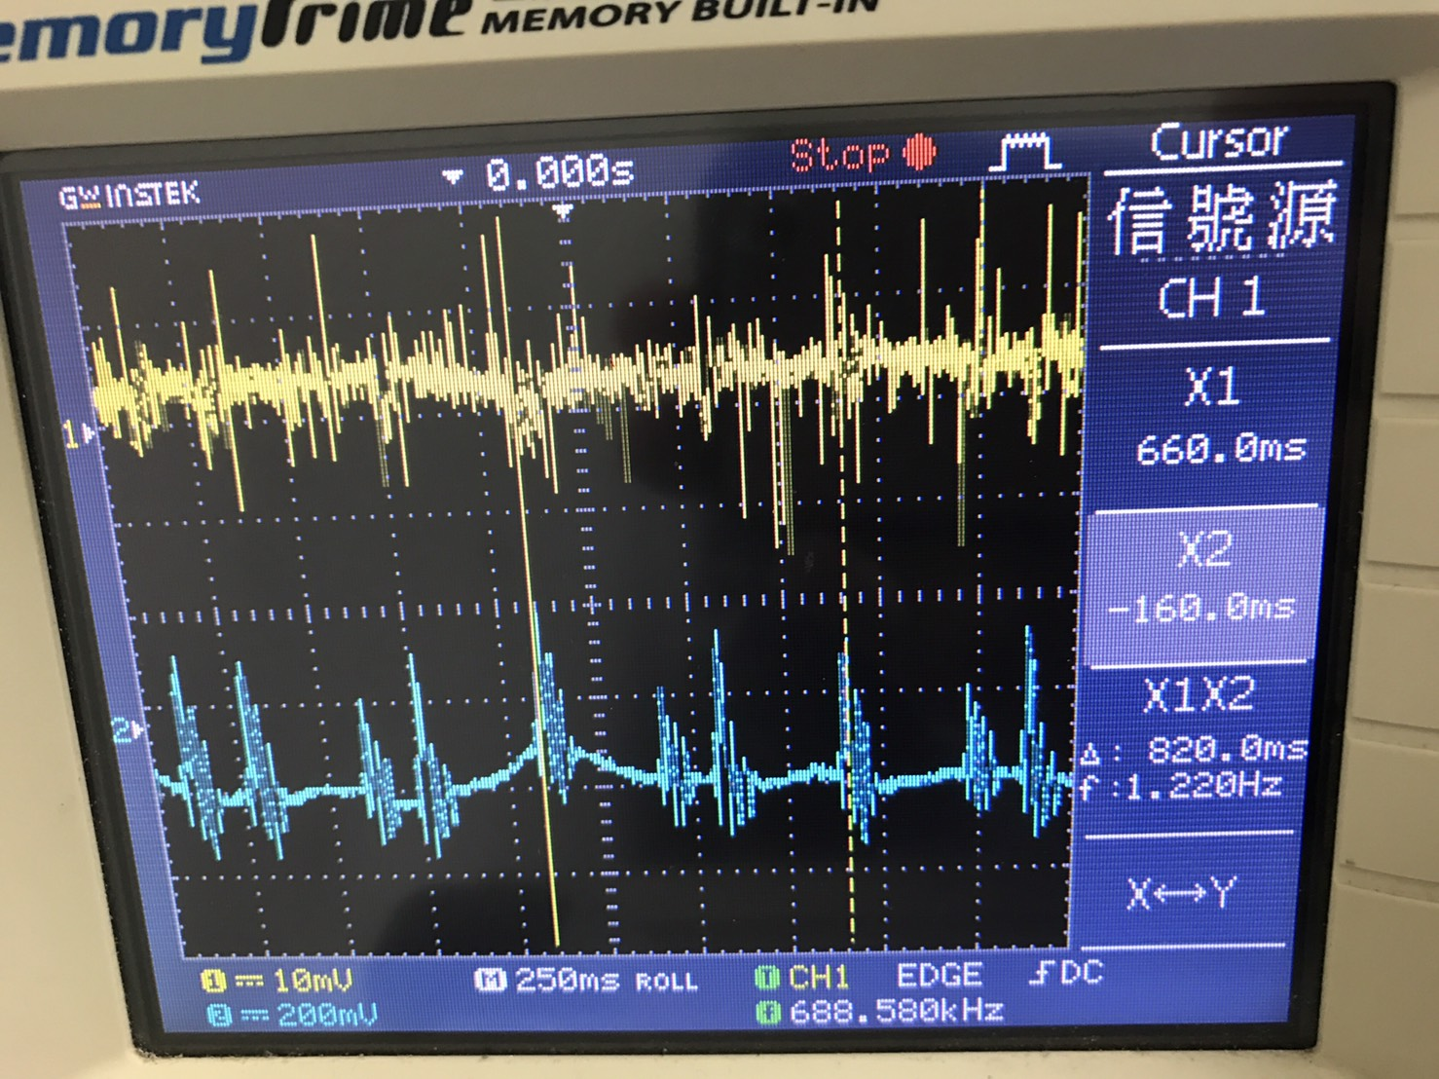
Signal after band pass filter on scope(sin) & amplifier signal
After band pass filter
After amplifier

Slide 19
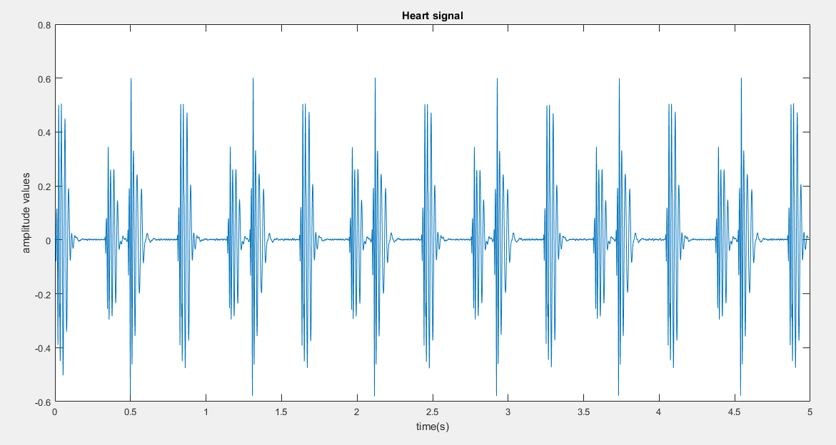

Hardware(plot heart signal)
Frequency$≈$1.25Hz

